Slide 1
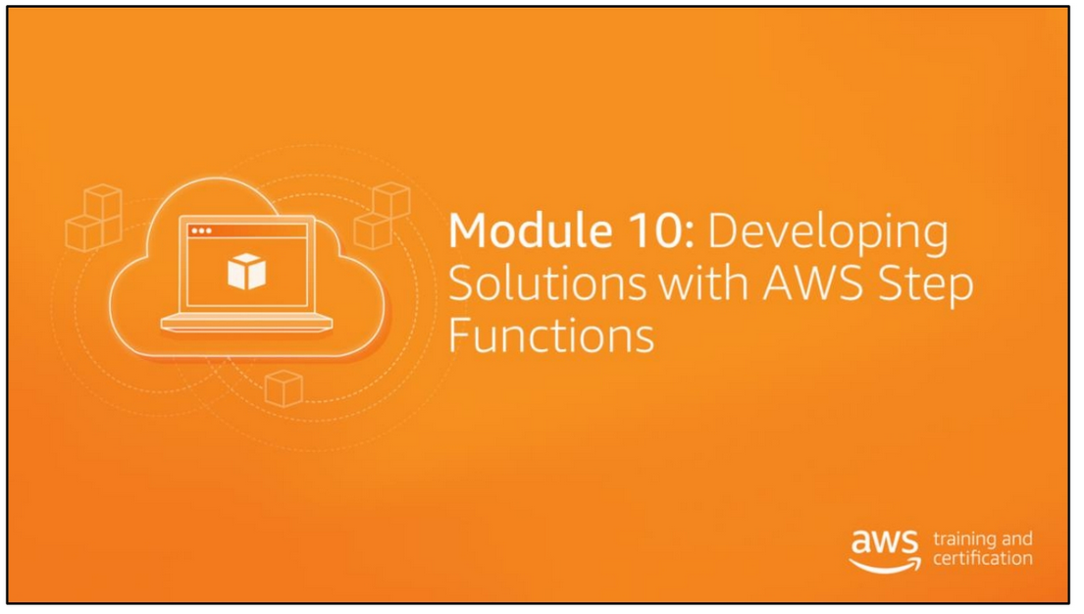

Slide 2
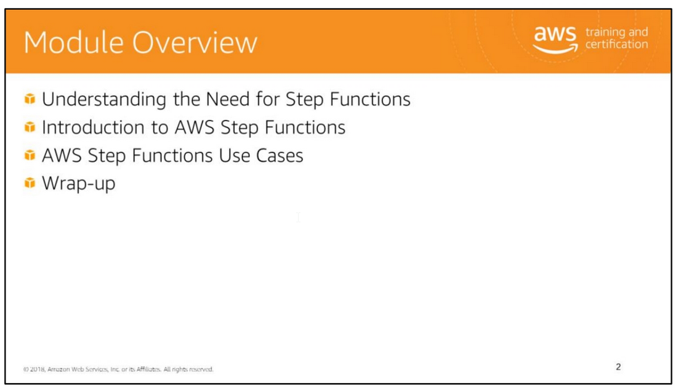

Slide 3
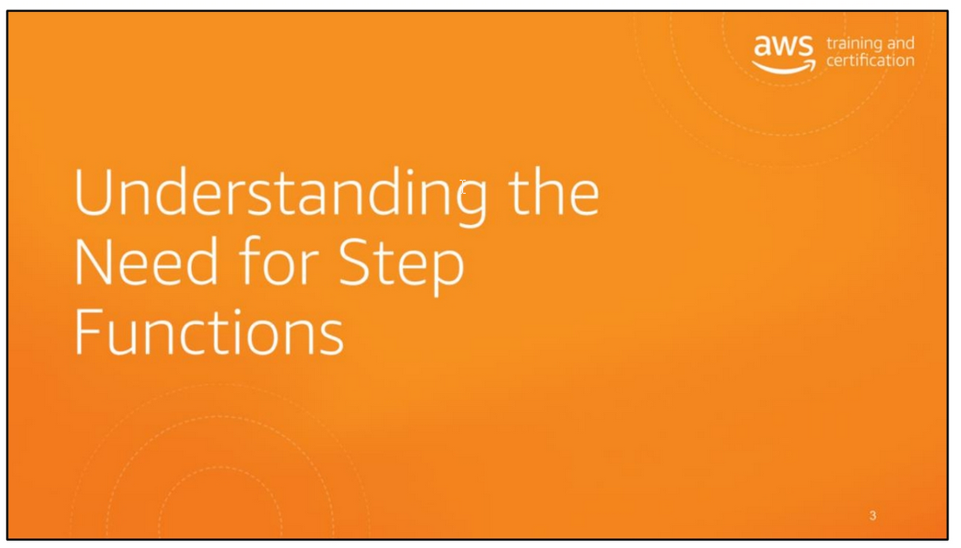

Slide 4
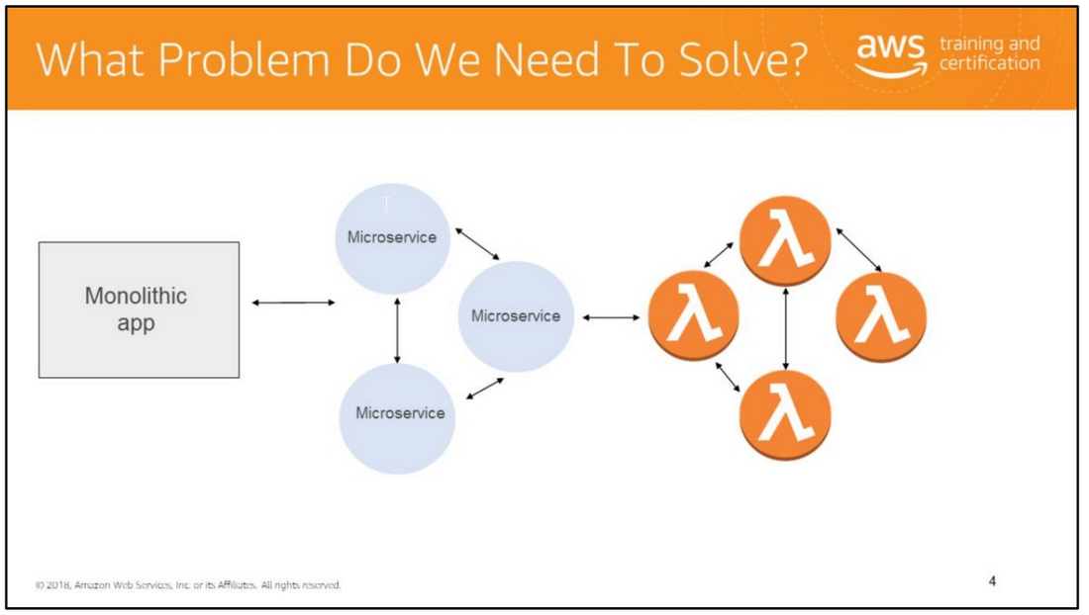
AWS Step Functions makes it easy to coordinate components of distributed applications and microservices by using visual workflows.
Microservices are processes that communicate with each other over a network to complete a larger goal.
Applications built as a collections of microservices are more resilient and easier to scale.
A very simple microservice, even serverless in this case, can be deployed with an AWS Lambda function.

Slide 5
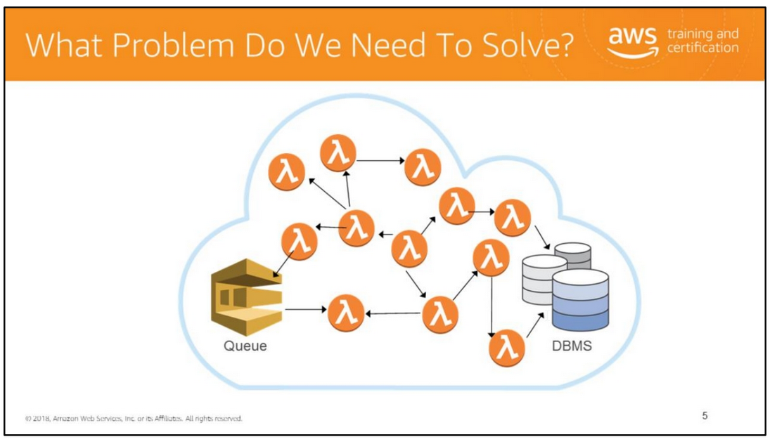
When you start to build large applications with AWS Lambda, you start to have lots of functions. With a serverless application, you start with one function.
You can do a lot with one Lambda function. Sometimes your application requires more than one function. You start to grow and have more functions and they continue to grow.
There are many combinations and patterns of two or three functions.
For example, you might only want a second function always follow first and only run only if and when the first function succeeds.
You can execute two functions parallel and feed the combined results in a third function, or choose between two functions based on the output of the first function.
You could chain Lambda functions; but what if one fails? You want to add mechanisms to keep track of state; maybe using a database.
Which can work, but may not scale; you could use a queue, but again you need to handle all retry and coordination yourself.
You want to scale out, easily handle errors and timeouts, easily build and operate and you want to know what’s going on with our application, to troubleshoot, and track performance.
This can be difficult in Serverless environments.

Slide 6
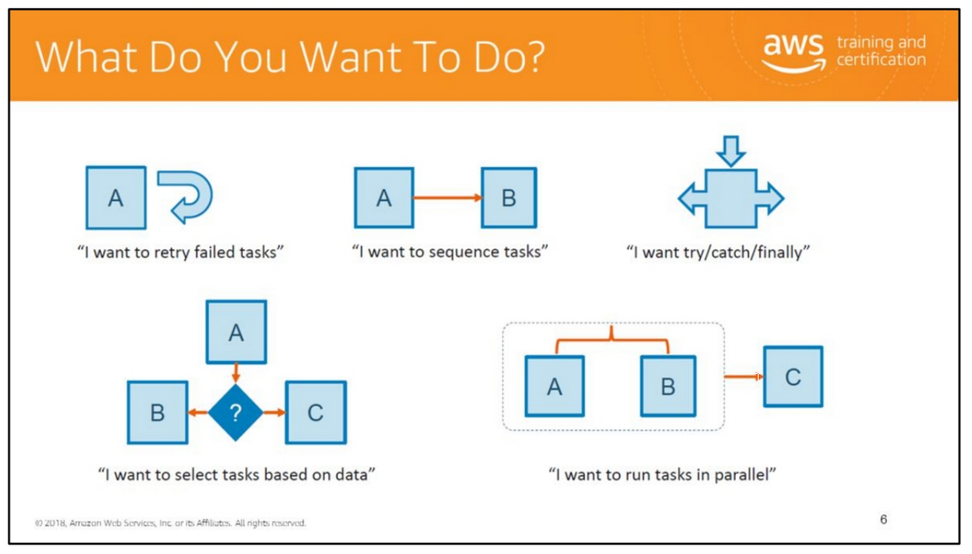
You need to have a coordination layer that can scale out, doesn’t lose state, handles with errors/timeouts, easy to build and operate, and it is auditable
(what is happening, why it took this decision, etc).

Slide 7
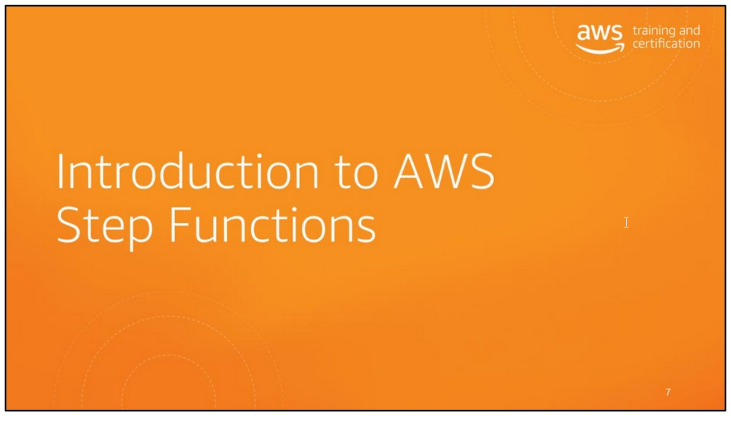

Slide 8
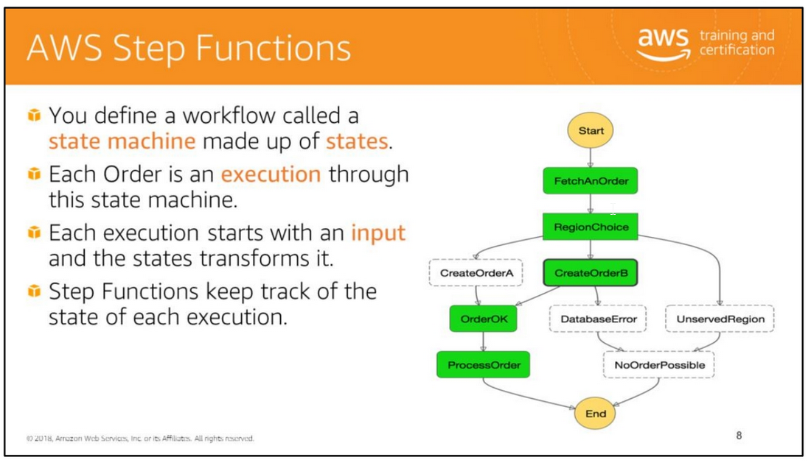
AWS Step Functions is a web service that enables you to coordinate the components of distributed applications and microservices using visual workflows.
You build applications from individual components that each perform a discrete function, or task, allowing you to scale and change applications quickly.
Step Functions provides a reliable way to coordinate components and step through the functions of your application.
Step Functions provides a graphical console to visualize the components of your application as a series of steps.
It automatically triggers and tracks each step, and retries when there are errors, so your application executes in order and as expected, every time.
Step Functions logs the state of each step, so when things do go wrong, you can diagnose and debug problems quickly.

Slide 9
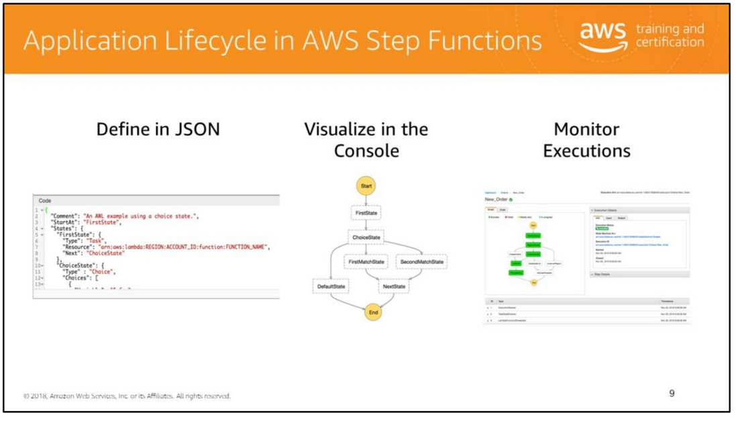
With AWS Step Functions, you define your workflow as a series of steps and transitions between each step, also known as a state machine.
You can easily coordinate multiple Lambda functions using visual workflows.
In Step Functions, we call these “states” and “state transitions”.
A simple state machine looks like this, and you define it using simple commands in JSON.
Step Functions ingests your JSON template and turns it into a real-time graphical view, helping you make sense of your state machine’s current state.
Where you can quickly visualize the your JSON defined state machine directly in the console.
When you start a state machine, you pass it input in the form of JSON, and each state changes or adds to this JSON blob as output, which becomes input to the next state.
The console provides this visualization and uses it to provide near-real-time information on your state machine execution.

Slide 10
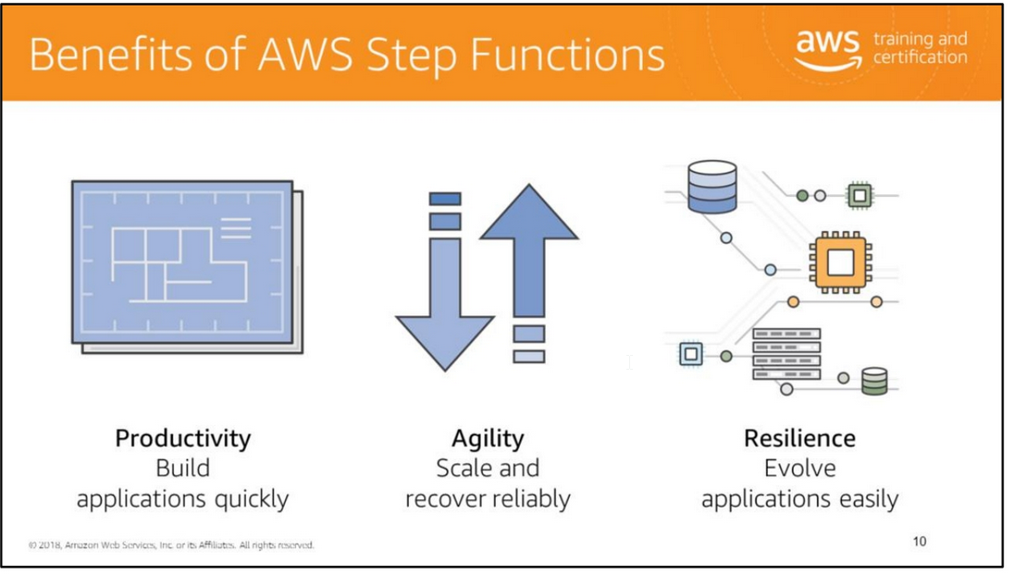
Build Applications Quickly
AWS Step Functions includes a visual console and blueprints for commonly used workflows that make it easy to coordinate the components of distributed applications into parallel
and/or sequential steps. You can build applications in a matter of minutes, and then visualize and track the execution of each step to help ensure the application is operating
as intended.
Scale and Recover
Reliably AWS Step Functions automatically triggers each step so your application executes in order and as expected.
It can handle millions of steps simultaneously to help ensure your application is available as demand increases.
Step Functions tracks the state of each step and handles errors with built-in retry and fallback, whether the step takes seconds or months to complete.
Evolve Applications
Easily AWS Step Functions makes it easy to change workflows and edit the sequence of steps without revising the entire application.
You can reuse components and steps without even changing their code to experiment and innovate faster.
Your workflow can support thousands of individual components and steps, so you can freely build increasingly complex applications.

Slide 11
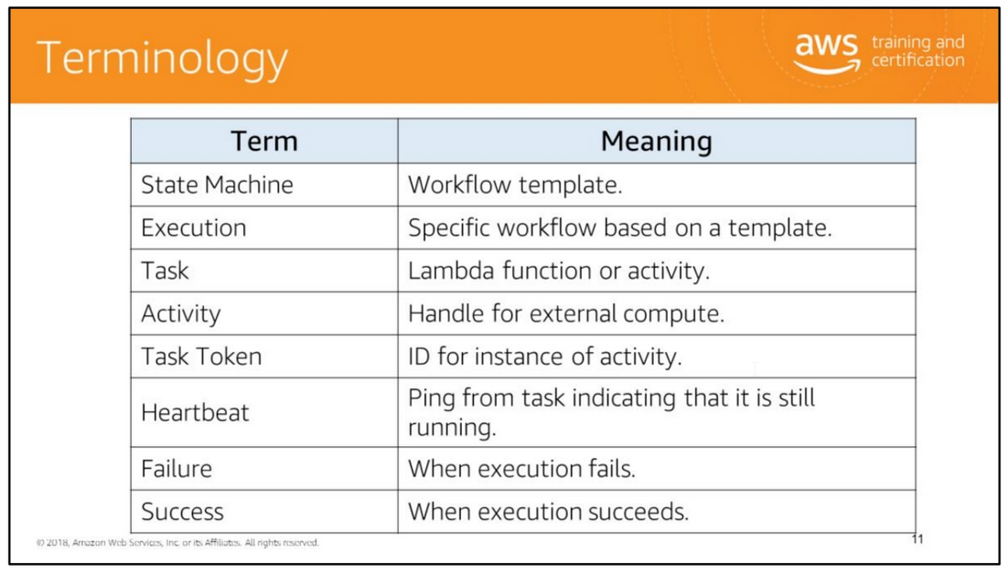

Slide 12
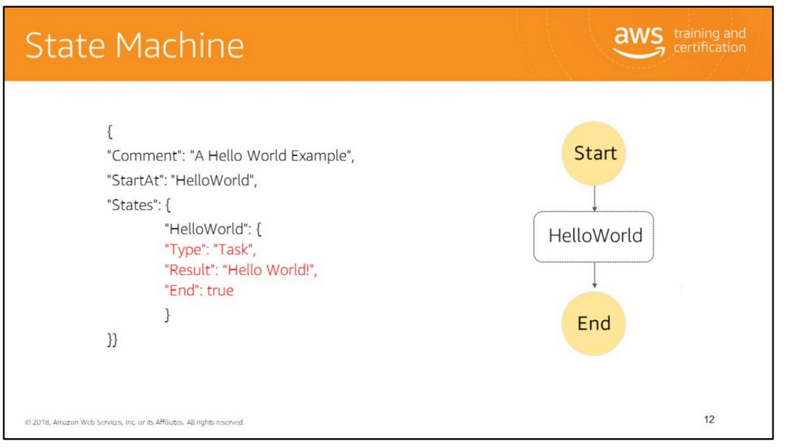
A state machine is an object that has a set number of operating conditions that depend on its previous condition to determine output.
This example is a JSON representation of a simple state machine that consists of a single task state.
The task calls out to a Lambda function (identified by ARN), passing the input of the state machine to the function.
When the function completes successfully, the state machine terminates with the same output as the function.
When an execution of this state machine is launched, the system begins with the state referenced in the StartAt field ("HelloWorld").
If this state has an "End": true field, the execution stops and returns a result. Otherwise, the system looks for a "Next": field and continues with that state next.
This process repeats until the system reaches a terminal state (a state with "Type": "Succeed", "Type": "Fail", or "End": true), or a runtime error occurs.

Slide 13
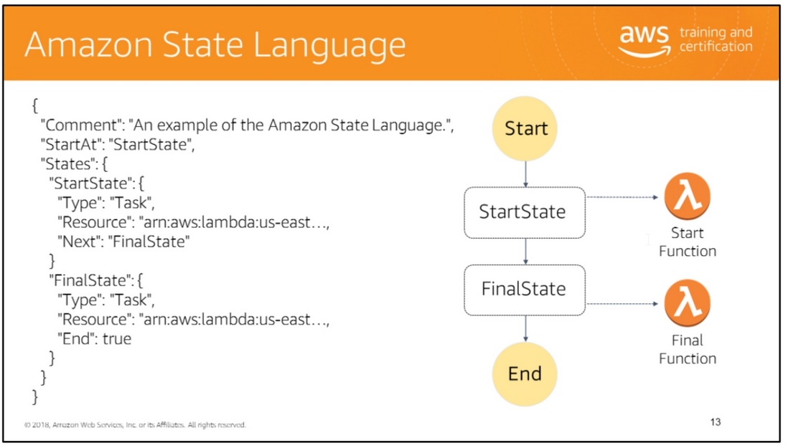
AWS Step Functions allows you to create and automate your own state machines within the AWS environment.
It does this with the use of a JSON-based Amazon State Language, that contains a structure made of various States, Tasks, Choices, Error handling and more.
Amazon States Language is a JSON-based, structured language used to define your state machine, a collection of states, that can do work (Task states), determine which states
to transition to next (Choicestates), stop an execution with an error (Fail states), and so on.
For more information, see the Amazon States Language Specification and Statelint, a tool that validates Amazon States Language code.
States share a number of common features :
• Each state must have a Type field indicating what type of state it is.
• Each state can have an optional Comment field to hold a human-readable comment about, or description of, the state.
• Each state (except a Succeed or Fail state) requires a Next field or, alternatively, can become a terminal state by specifying an End field.
Note: A Choice state may have more than one Next but only one within each Choice Rule. A Choice state cannot use End.

Slide 14
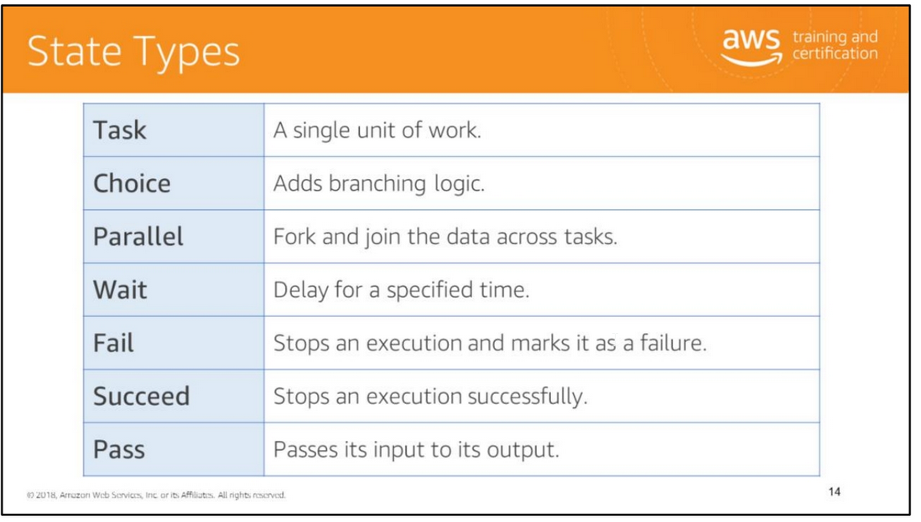
There are several types of states, all of which perform a variety of functions in your state machine, including:
• Do some work in your state machine (a Task state).
• Simply pass its input to its output or inject some fixed data (a Pass state)
• Make a choice between branches of execution (a Choice state)
• Begin parallel branches of execution (a Parallel state)
• Stop an execution with a failure or success (a Fail or Succeed state)
• Provide a delay for a certain amount of time or until a specified time/date (a Wait state)

Slide 15
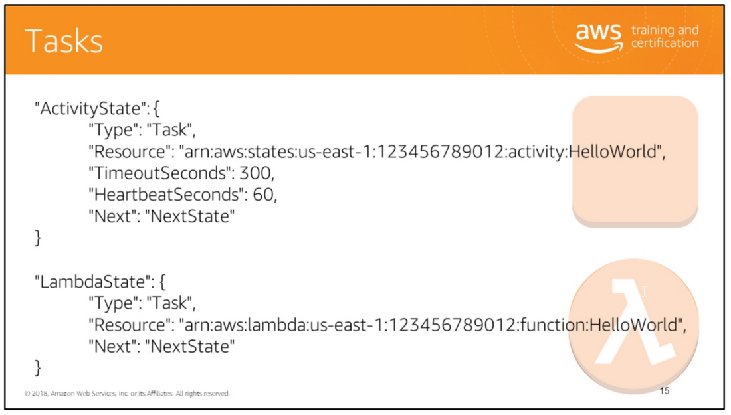
All work in your state machine is done by tasks. A task can be an activity or a Lambda function.
• An activity consists of program code or a task that waits for an operator to perform an action or to provide input.
You can host activities on Amazon EC2, on Amazon ECS, or even on mobile devices.
Activities poll Step Functions using the GetActivityTask and SendTaskSuccess, SendTaskFailure, and SendTaskHeartbeat API actions.
Activities represent workers (processes or threads), implemented and hosted by you, that perform a specific task.
• A Lambda function is a cloud-native task that runs on AWS Lambda.
You can write Lambda functions in a variety of programming languages, using the AWS Management Console or by uploading code to Lambda.
Lambda functions execute a function using AWS Lambda. To specify a Lambda function, use the ARN of the Lambda function in the Resource field.

Slide 16
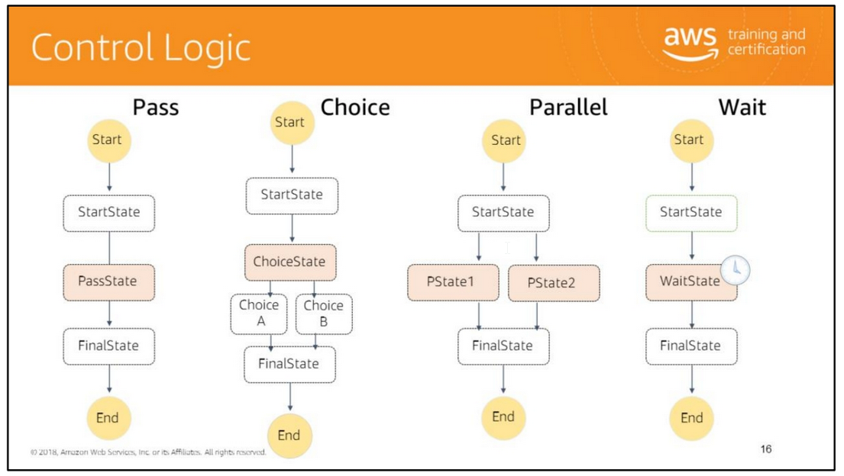

Slide 17
A Pass state ("Type": "Pass") simply passes its input to its output, performing no work. Pass states are useful when constructing and debugging state machines.
Here is an example of a Pass state that injects some fixed data into the state machine, probably for testing purposes.
"No-op": {
"Type": "Pass",
"Result": { "x-datum": 0.381018, "y-datum": 622.2269926397355 },
"ResultPath": "$.coords",
"Next": "End“
}
A Choice state ("Type": "Choice") adds branching logic to a state machine.
A Choice state must have a Choices field whose value is a non-empty array, whose every element is an object called a Choice Rule. A Choice Rule contains the following:
• A comparison – Two fields that specify an input variable to compared, the type of comparison, and the value to compare the variable to.
• A Next field – The value of this field must match a state name in the state machine.
• The following example checks whether the numerical value is equal to 1:
{
"Variable": "$.foo",
"NumericEquals": 1,
"Next": "FirstMatchState“
}
The Parallel state ("Type": "Parallel") can be used to create parallel branches of execution in your state machine.
A Parallel state causes AWS Step Functions to execute each branch, starting with the state named in that branch's StartAt field, as concurrently as possible,
and wait until all branches terminate (reach a terminal state) before processing the Parallel state's Next field.
Here is an example:
"LookupCustomerInfo": {
"Type": "Parallel",
"Branches": [ { "StartAt": "LookupAddress", "States": {
"LookupAddress": { "Type": "Task", "Resource": "arn:aws:lambda:us-east-1:123456789012:function:AddressFinder", "End": true } } }, { "StartAt":
"LookupPhone", "States": { "LookupPhone": { "Type": "Task", "Resource": "arn:aws:lambda:us-east-1:123456789012:function:PhoneFinder", "End": true
} } } ],
"Next": "NextState"
}
A Wait state ("Type": "Wait") delays the state machine from continuing for a specified time.
You can choose either a relative time, specified in seconds from when the state begins, or an absolute end-time, specified as a timestamp.
For example, the following Wait state introduces a ten second delay into a state machine:
"wait_ten_seconds": {
"Type": "Wait",
"Seconds": 10,
"Next": "NextState“
}

Slide 18
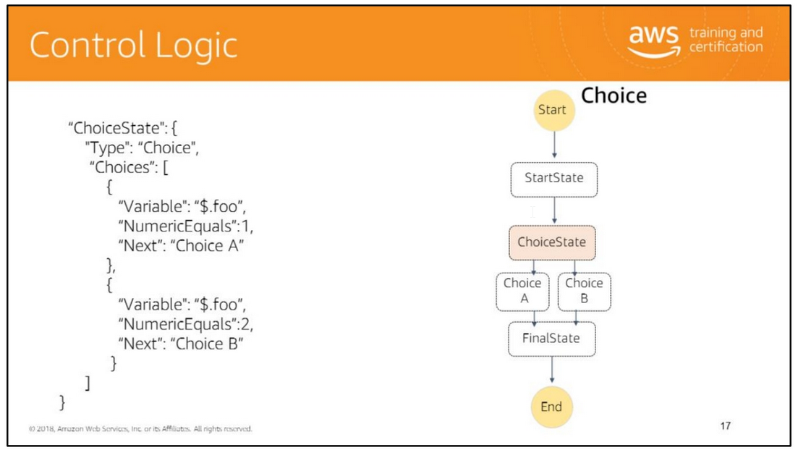

Slide 19
A Choice state ("Type": "Choice") adds branching logic to a state machine.
A Choice state must have a Choices field whose value is a non-empty array, whose every element is an object called a Choice Rule.
A Choice state may have more than one Next but only one within each Choice Rule.
A Choice state cannot use End.
A Choice Rule contains the following:
• A comparison – Two fields that specify an input variable to compared, the type of comparison, and the value to compare the variable to.
• A Next field – The value of this field must match a state name in the state machine.
• The following example checks whether the numerical value is equal to 1:
{
"Variable": "$.foo",
"NumericEquals": 1,
"Next": "FirstMatchState"
}

Slide 20
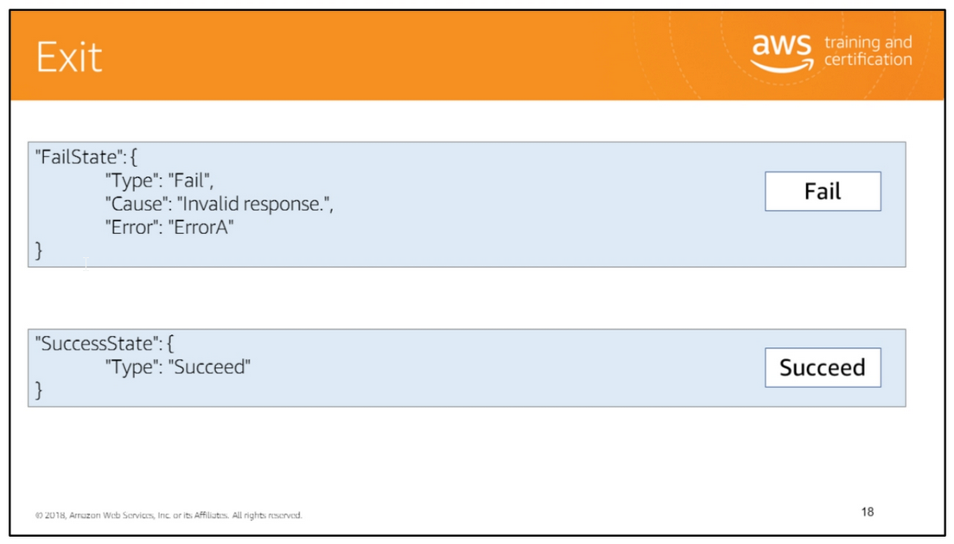

Slide 21
A Fail state ("Type": "Fail") stops the execution of the state machine and marks it as a failure.
The Fail state only allows the use of Type and Comment fields from the set of common state fields. In addition, the Fail state allows the following fields:
• Cause (Optional)Provides a custom failure string that can be used for operational or diagnostic purposes.
• Error (Optional)Provides an error name that can be used for error handling (Retry/Catch), operational or diagnostic purposes.
Because Fail states always exit the state machine, they have no Next field nor do they require an End field. The slide provides an example.
A Succeed state ("Type": "Succeed") stops an execution successfully. The Succeed state is a useful target for Choice state branches that don't do anything but stop the execution.
Because Succeed states are terminal states, they have no Next field, nor do they have need of an End field. See the slide for an example.

Slide 22
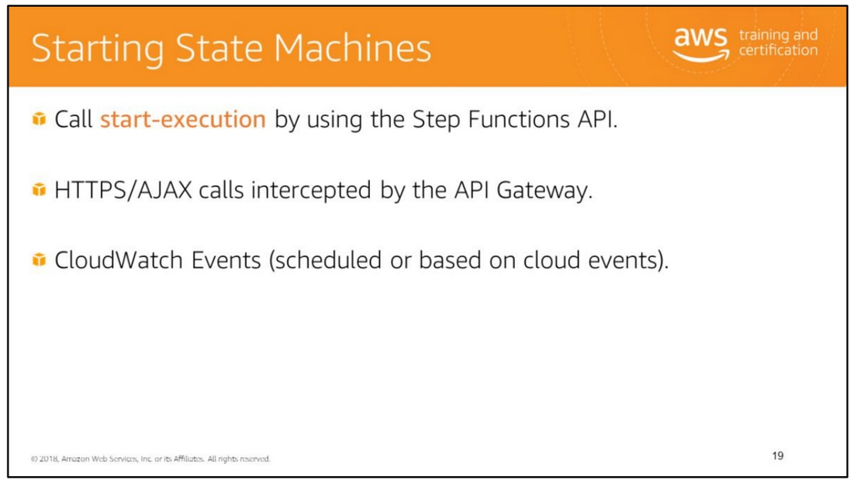

Slide 23
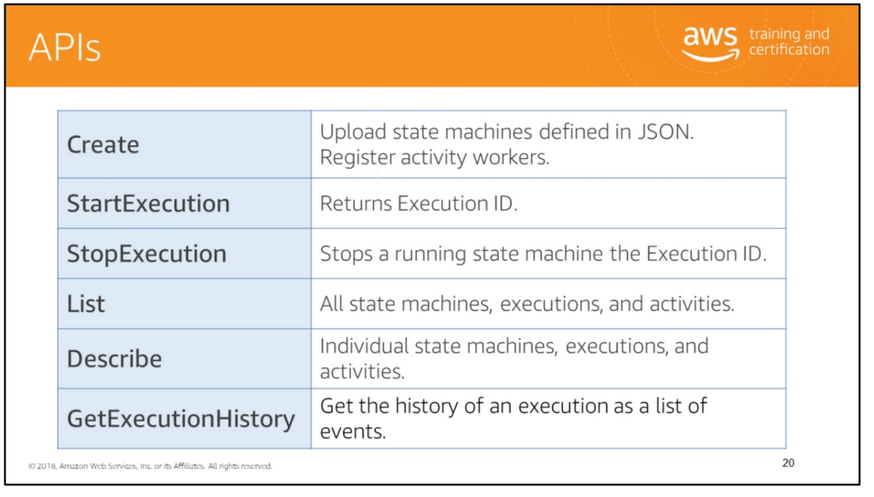

Slide 24
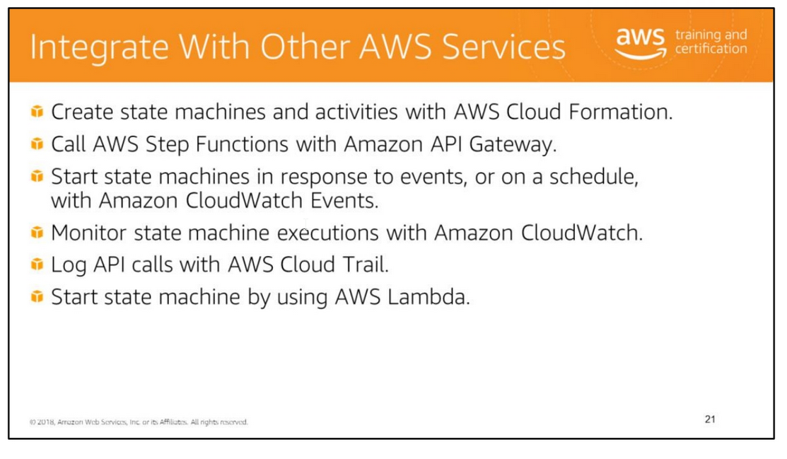

Slide 25
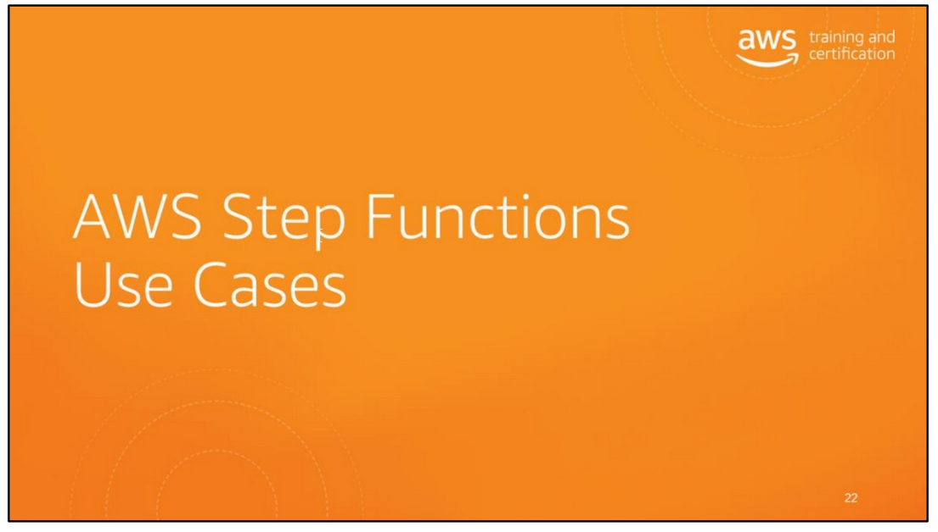

Slide 26
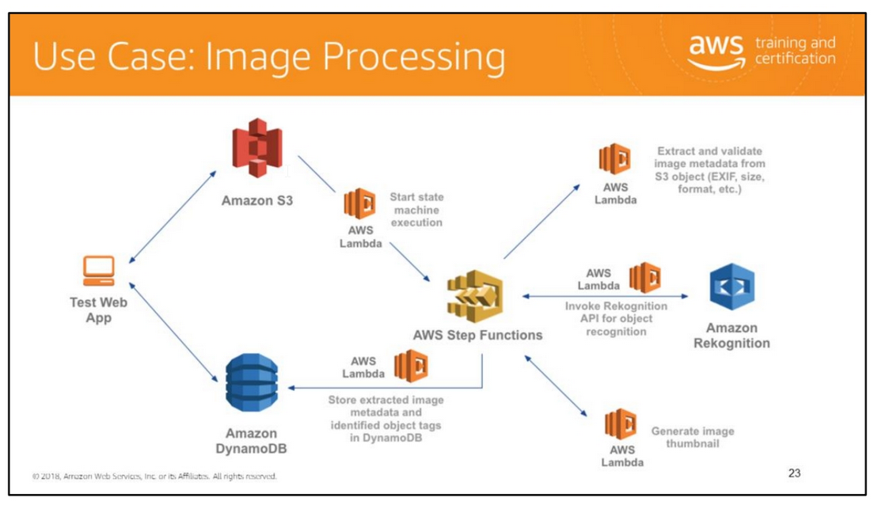
The Image Recognition and Processing Backend demonstrates how to use AWS Step Functions to orchestrate a serverless processing workflow by using AWS Lambda, Amazon S3,
Amazon DynamoDB and Amazon Rekognition. This workflow processes photos uploaded to Amazon S3 and extracts metadata from the image such as geolocation, size/format, time, etc.
It then uses image recognition to tag objects in the photo. In parallel, it also produces a thumbnail of the photo.
For more information, see https://github.com/aws-samples/lambda-refarch-imagerecognition.

Slide 27
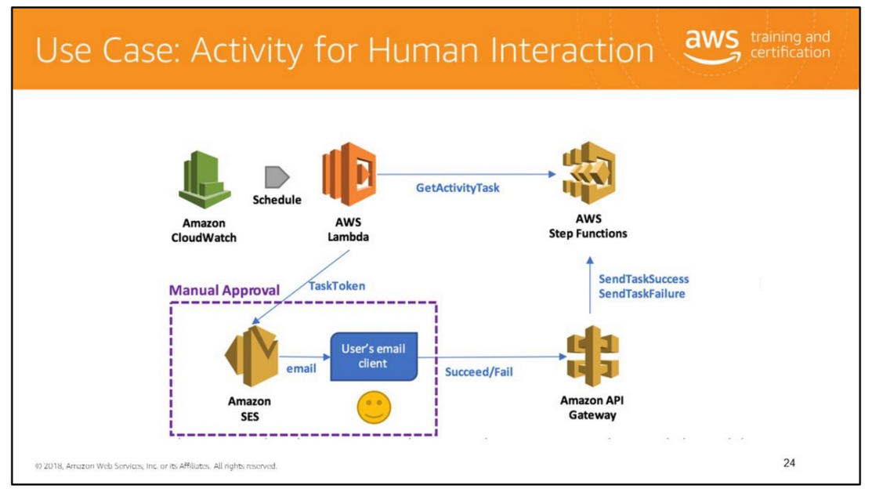
When the execution of a Step Functions state machine reaches an activity task state, Step Functions schedules the activity and waits for an activity worker.
An activity worker is an application that polls for activity tasks by calling GetActivityTask.
When the worker successfully calls the API action, the activity is vended to that worker as a JSON blob that includes a token for callback.
At this point, the activity task state and the branch of the execution that contains the state is paused. Unless a timeout is specified in the state machine definition,
which can be up to one year, the activity task state waits until the activity worker calls either SendTaskSuccess or SendTaskFailure by using the vended token.
This pause is the first key to implementing a manual approval step.
The second key is the ability in a serverless environment to separate the code that fetches the work and acquires the token from the code that responds with the completion status
and sends the token back, as long as the token can be shared, i.e., the activity worker in this example is a serverless application supervised by a single activity task state.
For more information, see https://aws.amazon.com/blogs/compute/implementing-serverless-manual-approval-steps-in-aws-step-functions-and-amazon-api-gateway/.

Slide 28
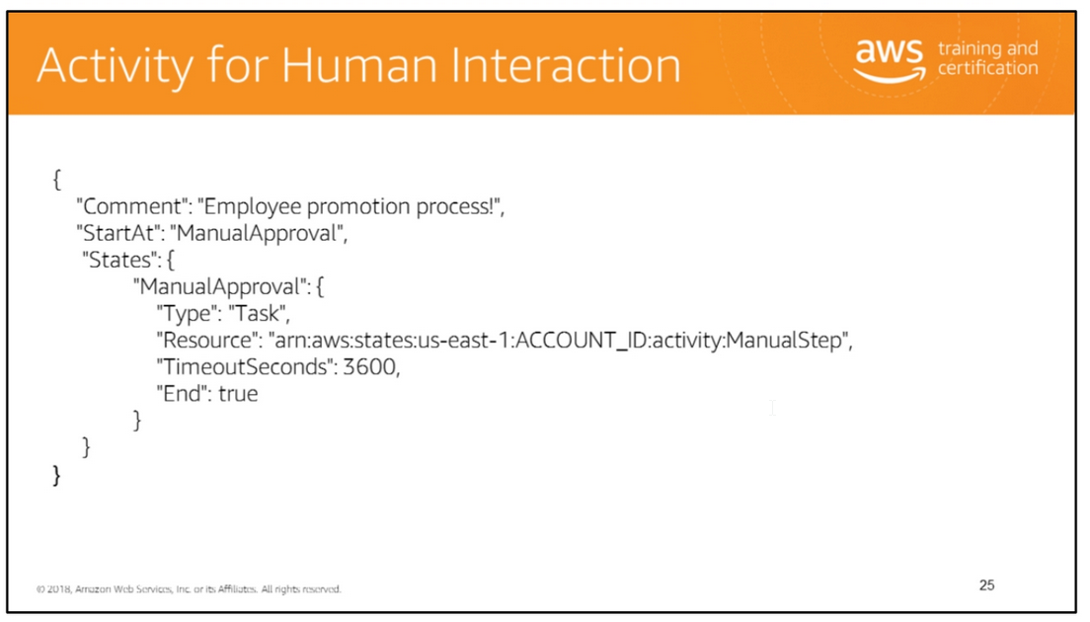

Slide 29

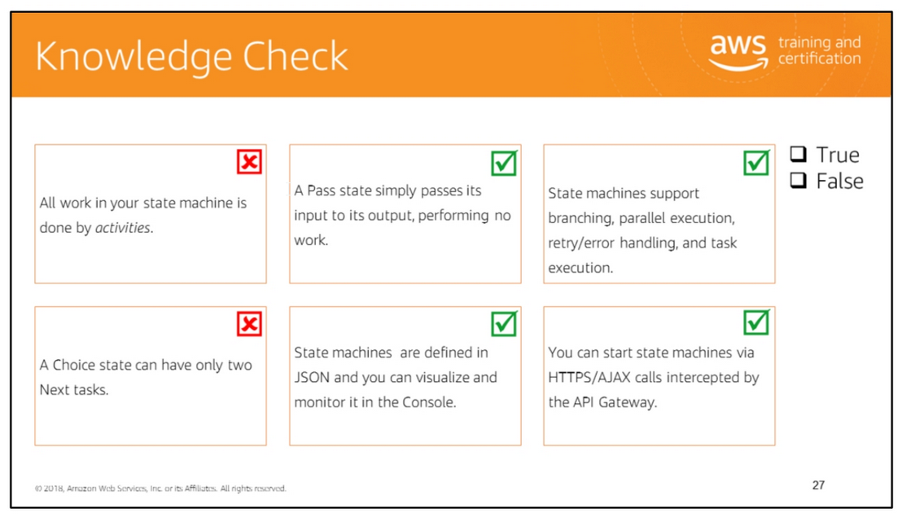
Read left to right:
(False) All work in your state machine is done by tasks.
(True)
(True)
(False) A Choice state may have more than one Next but only one within each Choice Rule
.(True)
(True)

Slide 30
